Slide 1




Slide 2
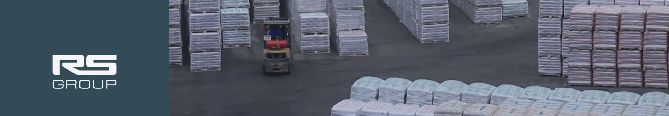
Core Values
Do The Right Thing
We act with integrity, even when no one is watching.
Fanatical Commitment to Service
We go above and beyond to deliver exceptional service that exceeds expectations.
We Not Me
We prioritize teamwork, collaboration, and collective success over individual gain.
Can Do Attitude
We approach every challenge with positivity, resilience, and a solution-focused mindset.

Slide 3


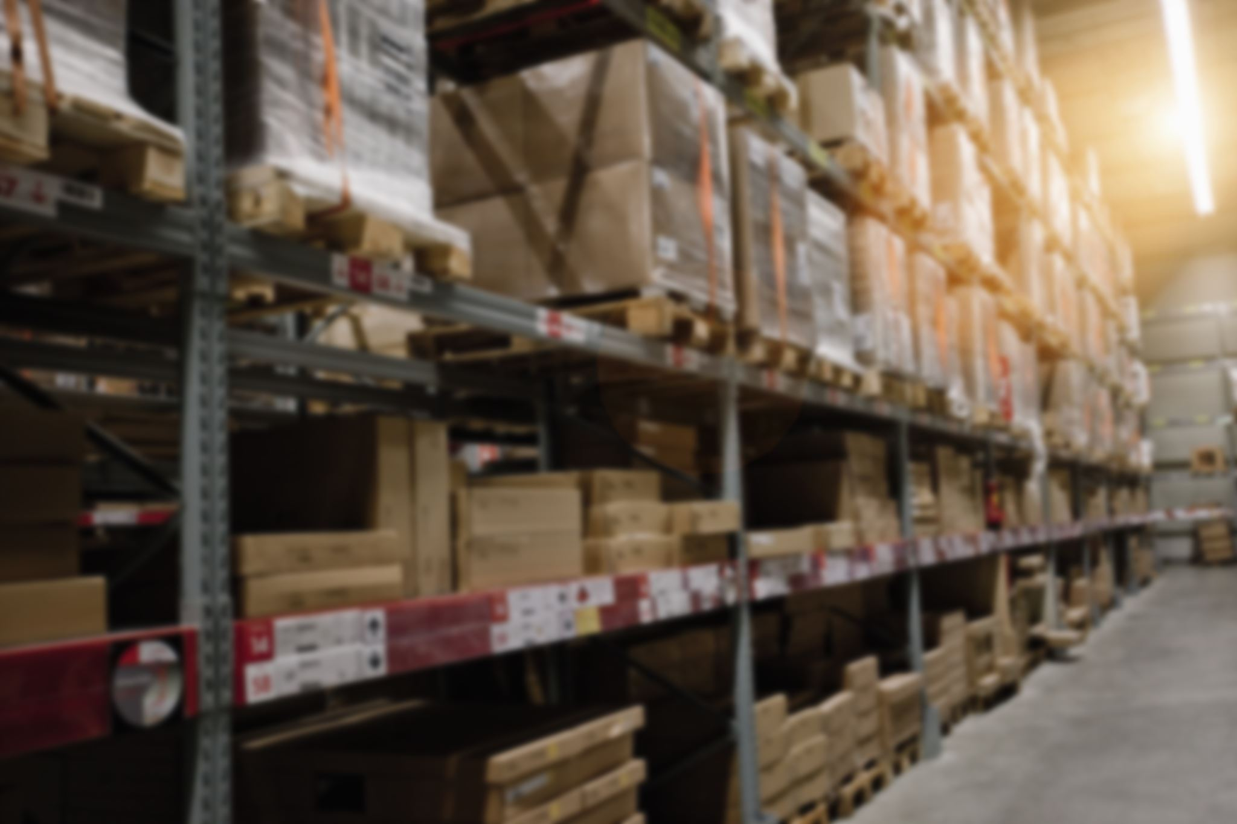
RSG - Ready ship go!
We design, implement, manage, and continuously improve customer logistics programs for each client. Servicing each with excellence.
Carrier
3PL
Warehouse
Asset Based Specialized Carrier
Specialized Carrier both TL and LTL
Same day courier and expedited Services
High Value (audio-visual and healthcare products)
Dry Ice Shipping
TSA Certification
Technology Driven 3PL
National LTL, TL, and drayage
Value focused freight solutions
Real time visibility and tracking solutions
Fanatical Commitment to Customer Service
Data analytics and telematics solutions
Project management
Atlanta Metropolitan Area
240,000 square feet
Cross dock
Transload
Bulk Storage
Racked Storage
Kitting

Slide 4

Technology
EXTENSIV – WMS
An online portal to view and manage warehouse inventory and functions across all RS Group managed warehouses
Any number of automated reports can be scheduled and emailed as required
Scalable without additional training
Able to integrate via EDI, API, CSV Upload, etc.
TAI TMS – 3PL
Online portal for real time tracking of shipments
Easy to use LTL portal
Automated invoices, statements, and customer reports can be created to fit individual client’s needs
EDI capabilities

Slide 5
Technology
SAMSARA – Trucking Division
Accurate and up-to-date vehicle tracking
ELD and DOT compliance
Real time safety updates for rewarding and coaching good driving behaviors
FREIGHTPATH – Carrier Division
Vehicle tracking and Visibility
Customer portal access
Easy self-scheduling

Slide 6
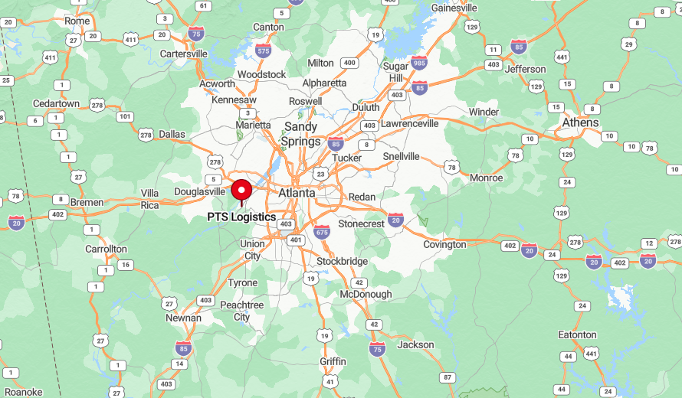
wAREHOUSING
240,000 sq. ft
Over 20 dock doors
Ground Level unload available
Located within 10 miles of local rails and Hartsfield-Jackson Atlanta International Airport
Cross-docking capabilities
Racking and floor space available

Slide 7
Transportation Management functional building blocks
Flexible, automated, plug & play
Strategic
Carrier sourcing and contracting
Control tower 24/7 support
Advanced planning
(Delivery planning drives factory)
Exception management
pro-active
Optimization / order consolidation (carrier, load, route mode)
Exception Management
reactive
Network optimization
Supply Chain design
Mode selection
Exception notification (handling)
Transport Network optimization
Carrier selection
Milestone Tracking
Continuous improvement
(root cause analysis)
Shipping instructions and documentation
Visibility, shipment monitoring
Carrier management
(Follow-up KPI)
System & Solution planning
(backward)
Manual shipment creation
TM Business Analytics
Standard planning
(forward)
Delivery trigger, shipment booking
Carrier KPI reporting
Transportation planning
Transportation execution
Post shipment management
Operational
Legend:
Automate
Out-source
Partnership
In-source

Slide 8
The changing environment requires new business models and partnership strategies
Shared accountability model
Joint commitment to quality, efficiency, and cost metrics = value us and our customers
Customer
RS Group
Common Goals
Predictability
Shared risk
Continuous improvement
Reduced operating expense
Innovation

Slide 9

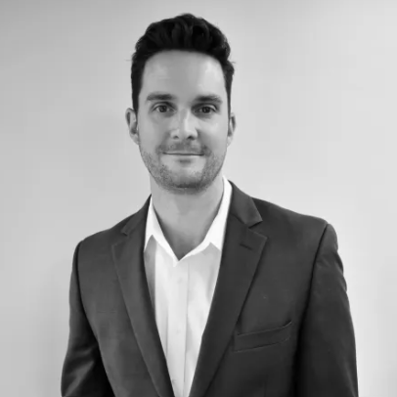
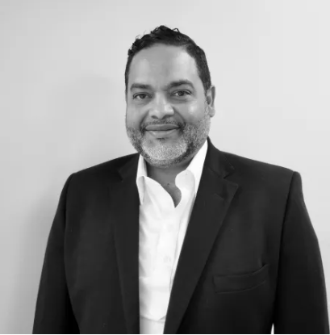
A Message From Our Leadership
At RS Group, our mission is to provide unparalleled customer service in the logistics and warehousing industry. We are dedicated to ensuring each shipment and storage solution is managed with precision and care, leveraging our extensive network and innovative technology to meet our clients' needs efficiently. Our commitment is to build lasting relationships with our clients by delivering exceptional service and tailored logistics and warehousing solutions. We strive to be the dependable partner that businesses trust for all their transportation, storage, and fulfilment requirements, guaranteeing excellence in every aspect.
Brent Staton
Founder & CEO
Christian Reyes
Founder & CEO

Slide 10
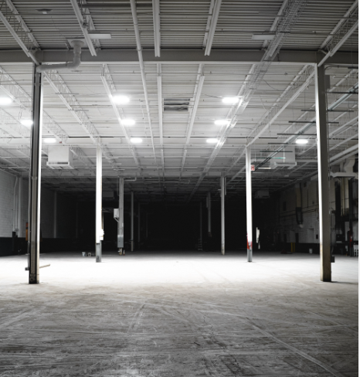

Get a quote today!

